Slide 1

STUDIA PODYPLOMOWE
POLITECHNIKA BIAŁOSTOCKA
JavaScript

Slide 2
#5

Slide 3
Internal
type
coercion

Slide 4
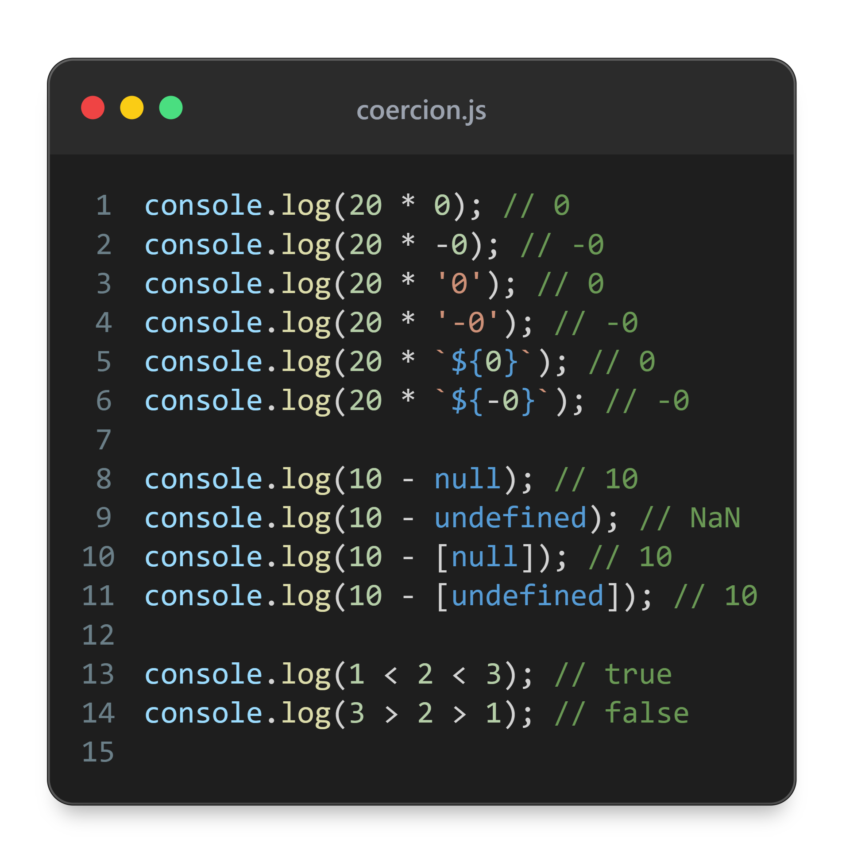

Slide 5
toString
PRIMITIVES
1 | ‘1’
1.23 | ‘1.23’
Infinity | ‘Infinity’
NaN | ‘NaN’
0 | ‘0’
-0 | ‘0’
true | ‘true’
false | ‘false’
null | ‘null’
undefined | ‘undefined’

Slide 6
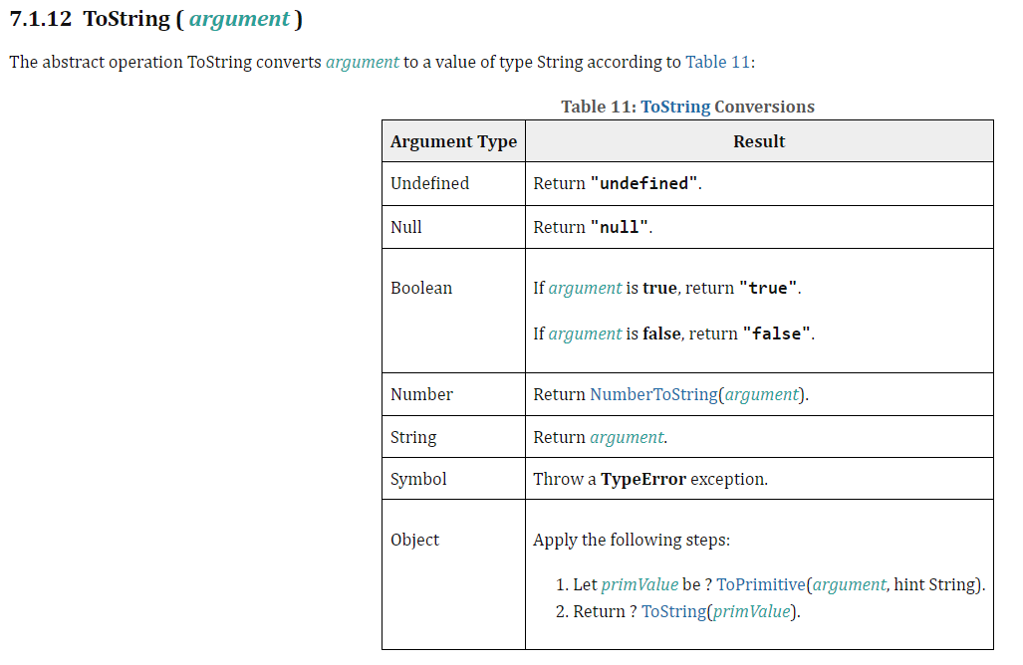

Slide 7
toNumber
PRIMITIVES
‘hello’ | NaN
‘1’ | 1
‘1.23’ | 1.23
‘’ | 0
‘0’ | 0
‘-0’ | -0
‘0001’ | 1
null | 0
undefined | NaN
true | 1
false | 0

Slide 8
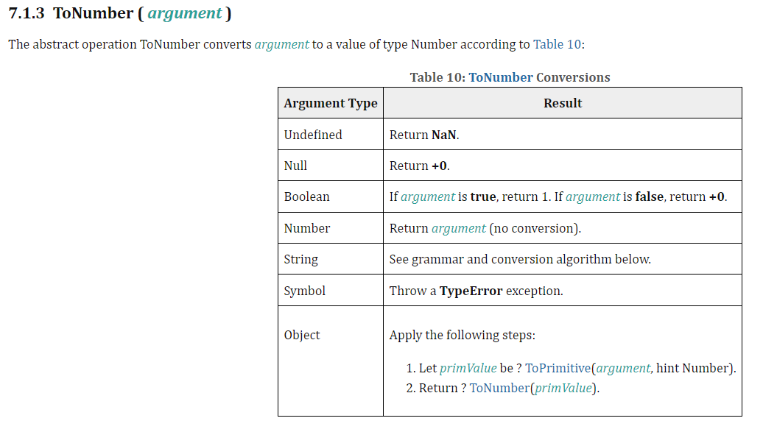

Slide 9
To Primitive
Internal method of JS
Accepts hint as parameter
It can be either number or string

Slide 10
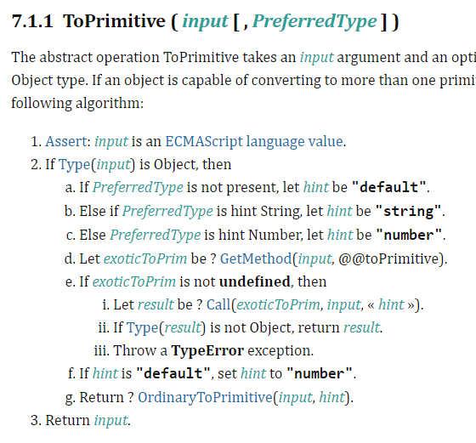

Slide 11
toPrimitive
(string)
call .toString()
call .valueOf()
(number)
call .valueOf()
call .toString()

Slide 12
toPrimitive (string)
OBJECTS
{} | ‘[object Object]’
{toString() {return ‘hello’}} | ‘hello’
[1,2,’hello’] | ‘1,2,hello’
[] | ‘’
[null, undefined] | ‘,’

Slide 13
toPrimitive (number)
{} | NaN
{valueOf() {return 1}} | 1
[‘1’,’2’] | NaN
[1,2] | NaN
[‘1’] | 1
[1] | 1
[‘’] | 0
[‘0’] | 0
[null] | 0
[undefined] | 0

Slide 14
toBoolean
Falsy
false
NaN
null
undefined
0
-0
0n
‘’
Truthy
Everything else

Slide 15
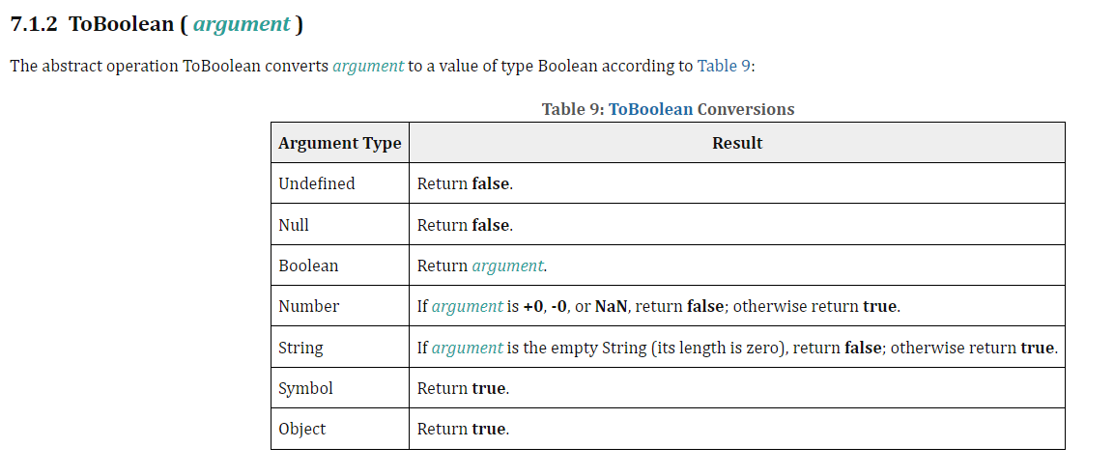

Slide 16
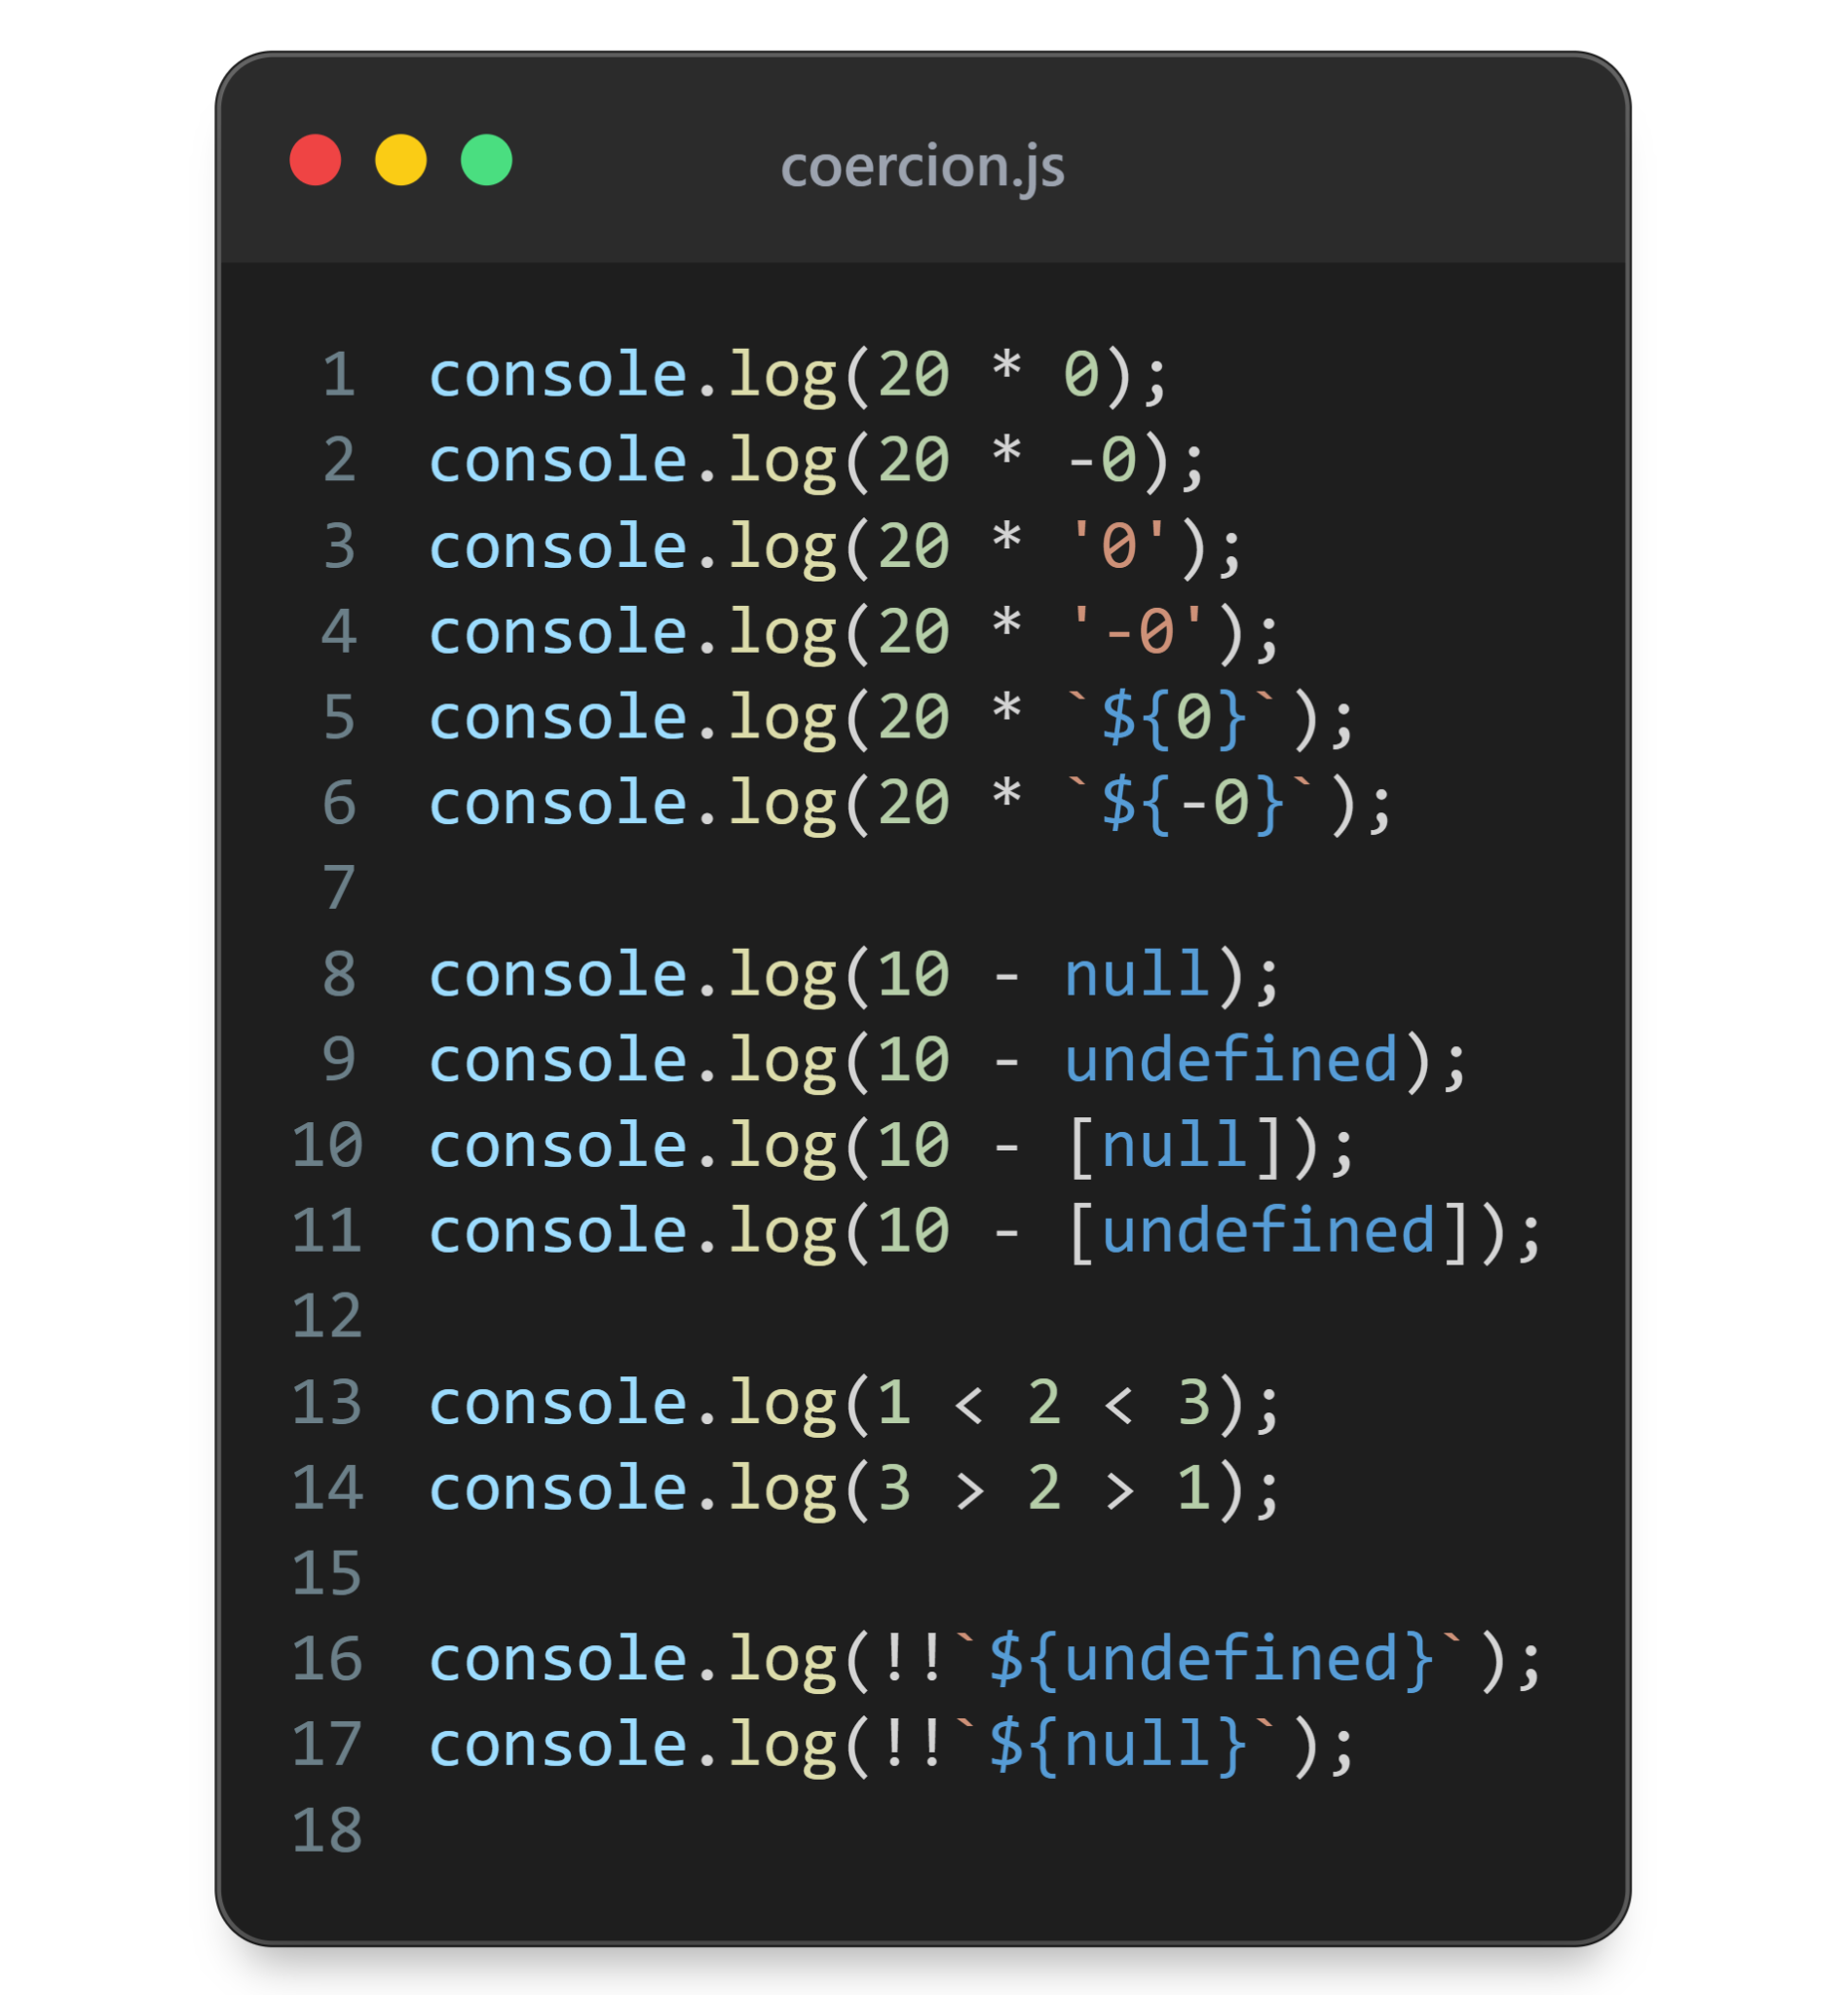
Quiz

Slide 17
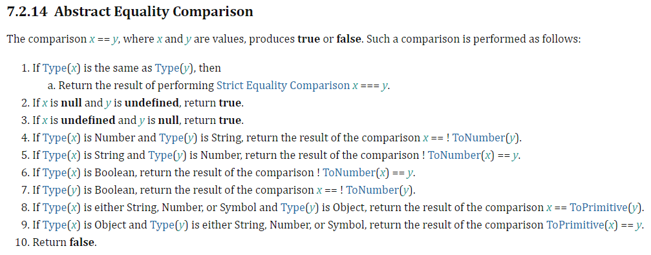
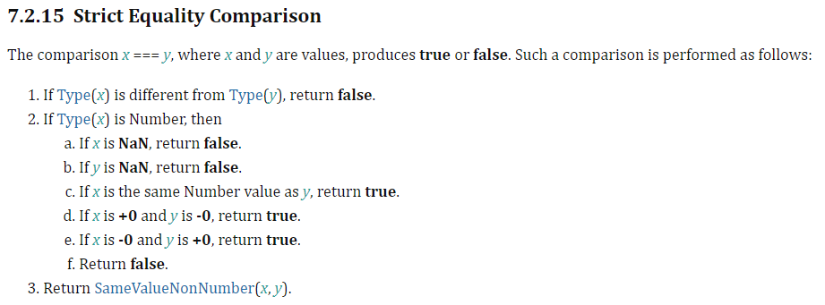
== (loose equality)
=== (strict equality)

Slide 18
Iterators

Slide 19
Definitions
Iteration - process of accessing data one by one from a collection
Iterator - an interface that allows this process
Iterable - a collection of data that can be iterated

Slide 20
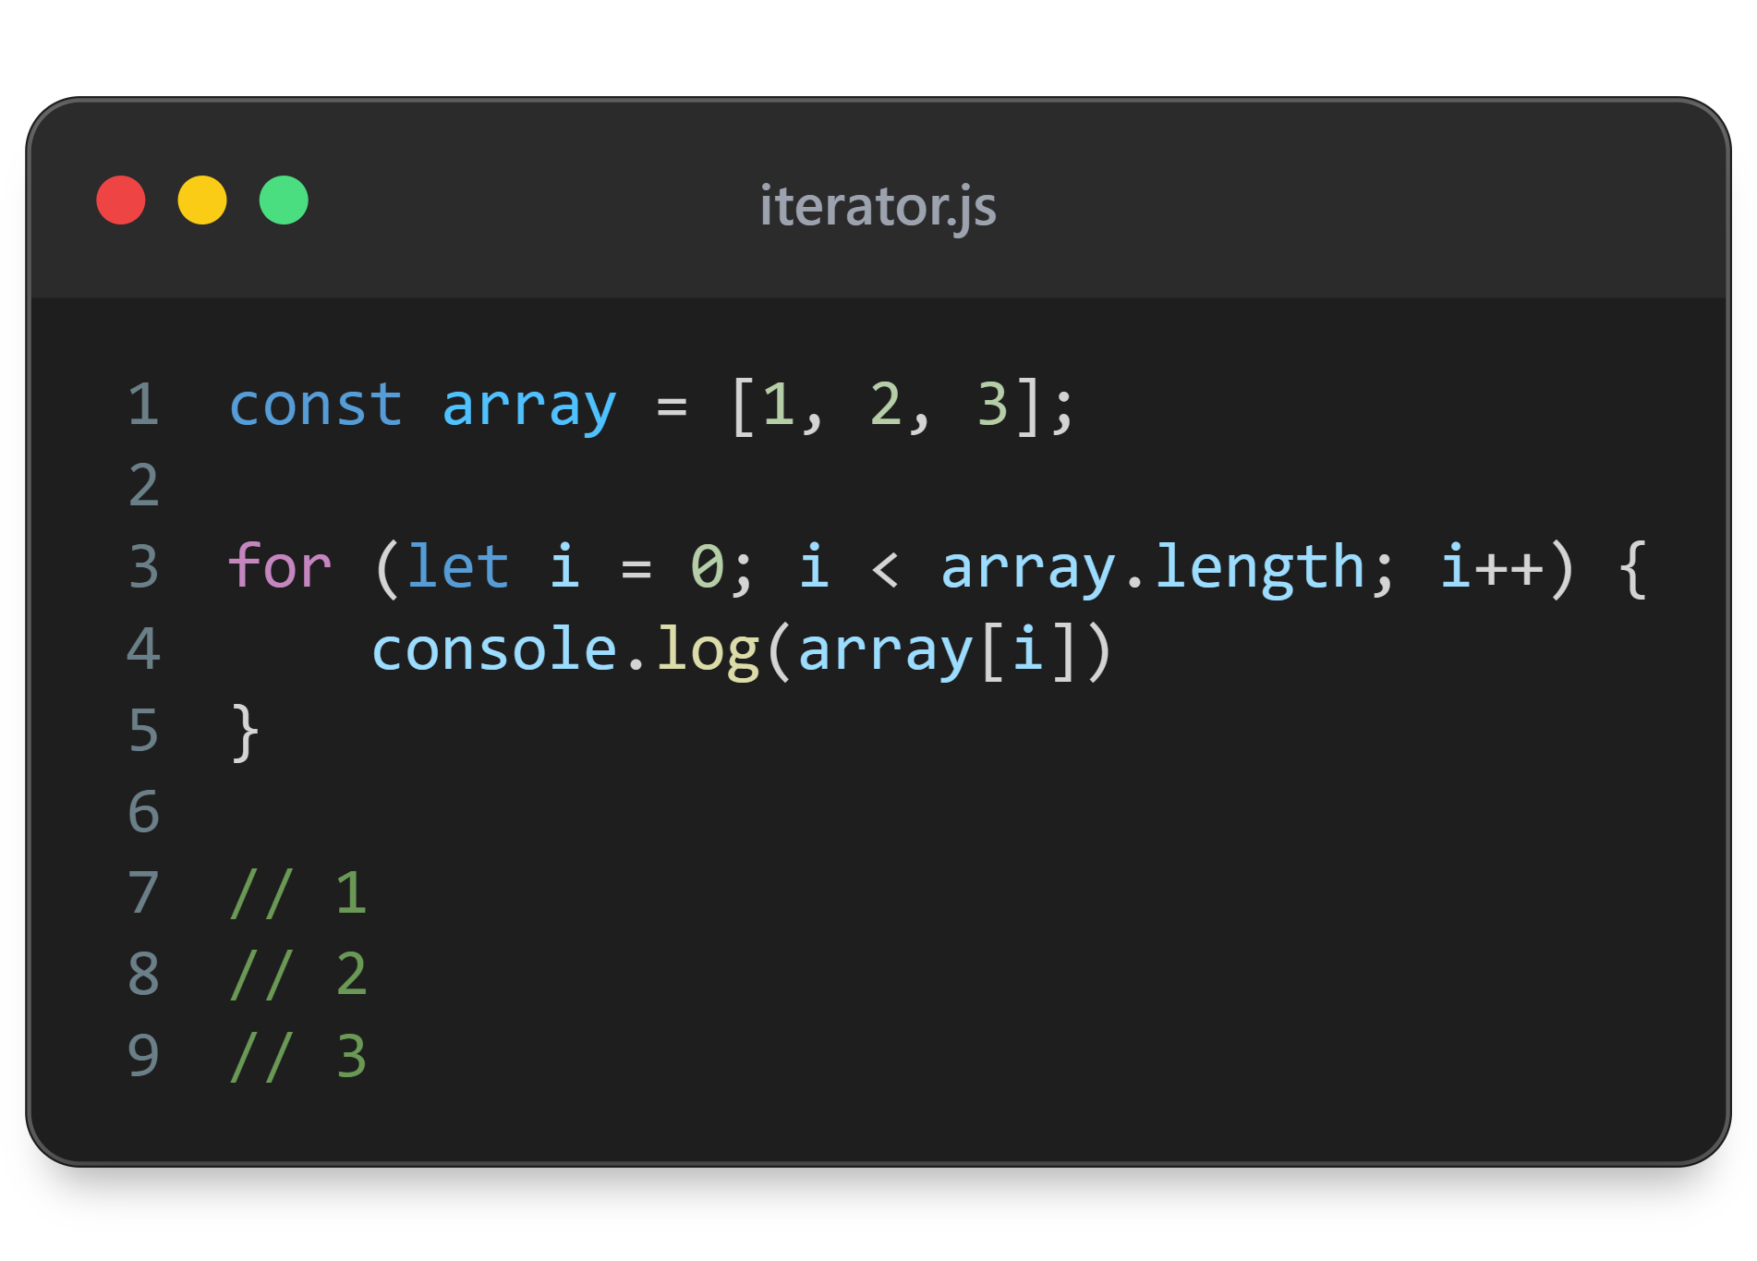

Slide 21
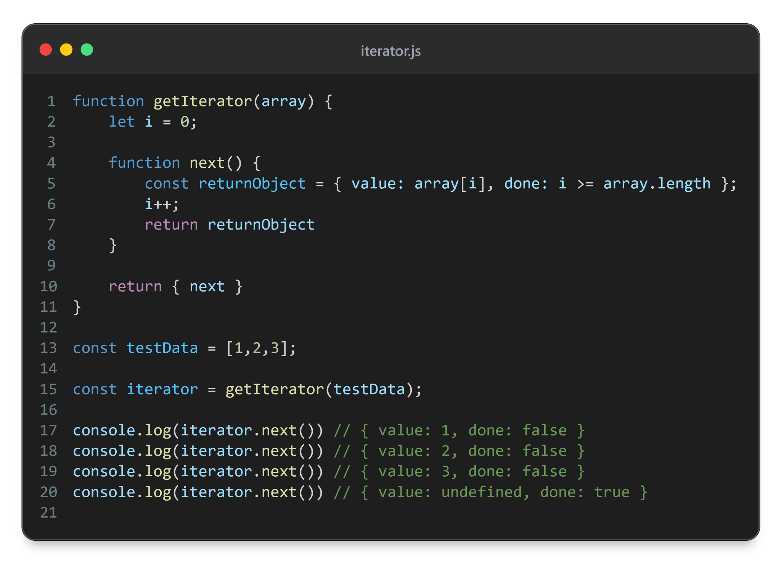

Slide 22
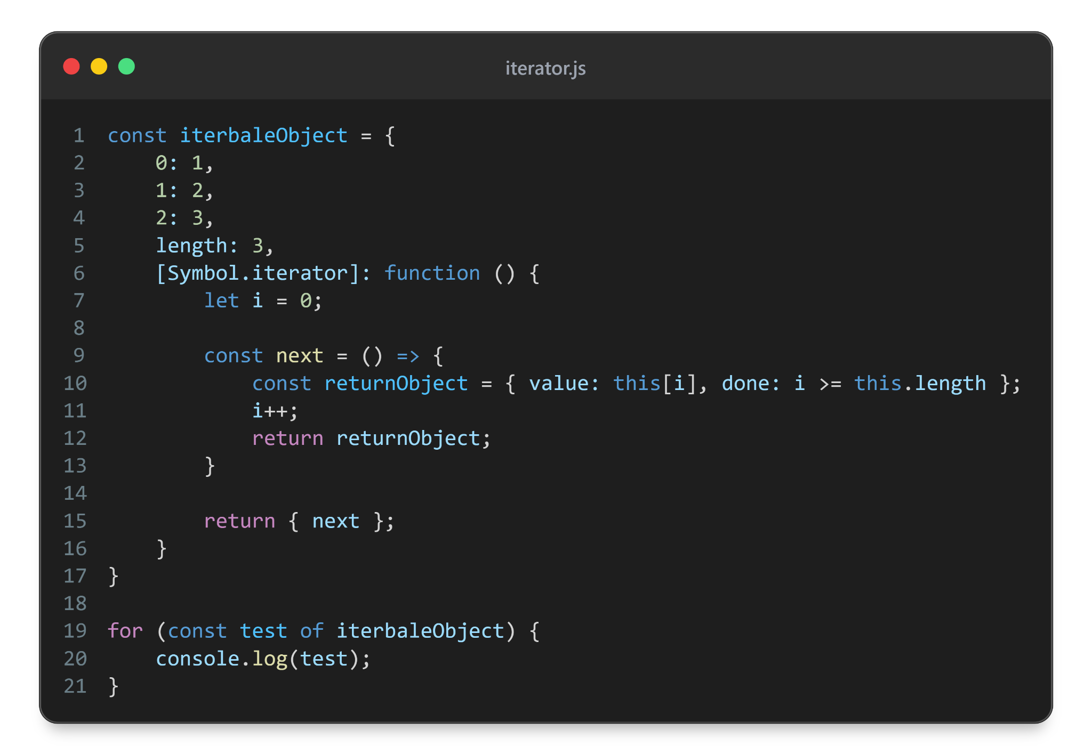

Slide 23
Generator
A special type of function that creates iterator
But it has some super powers!

Slide 24
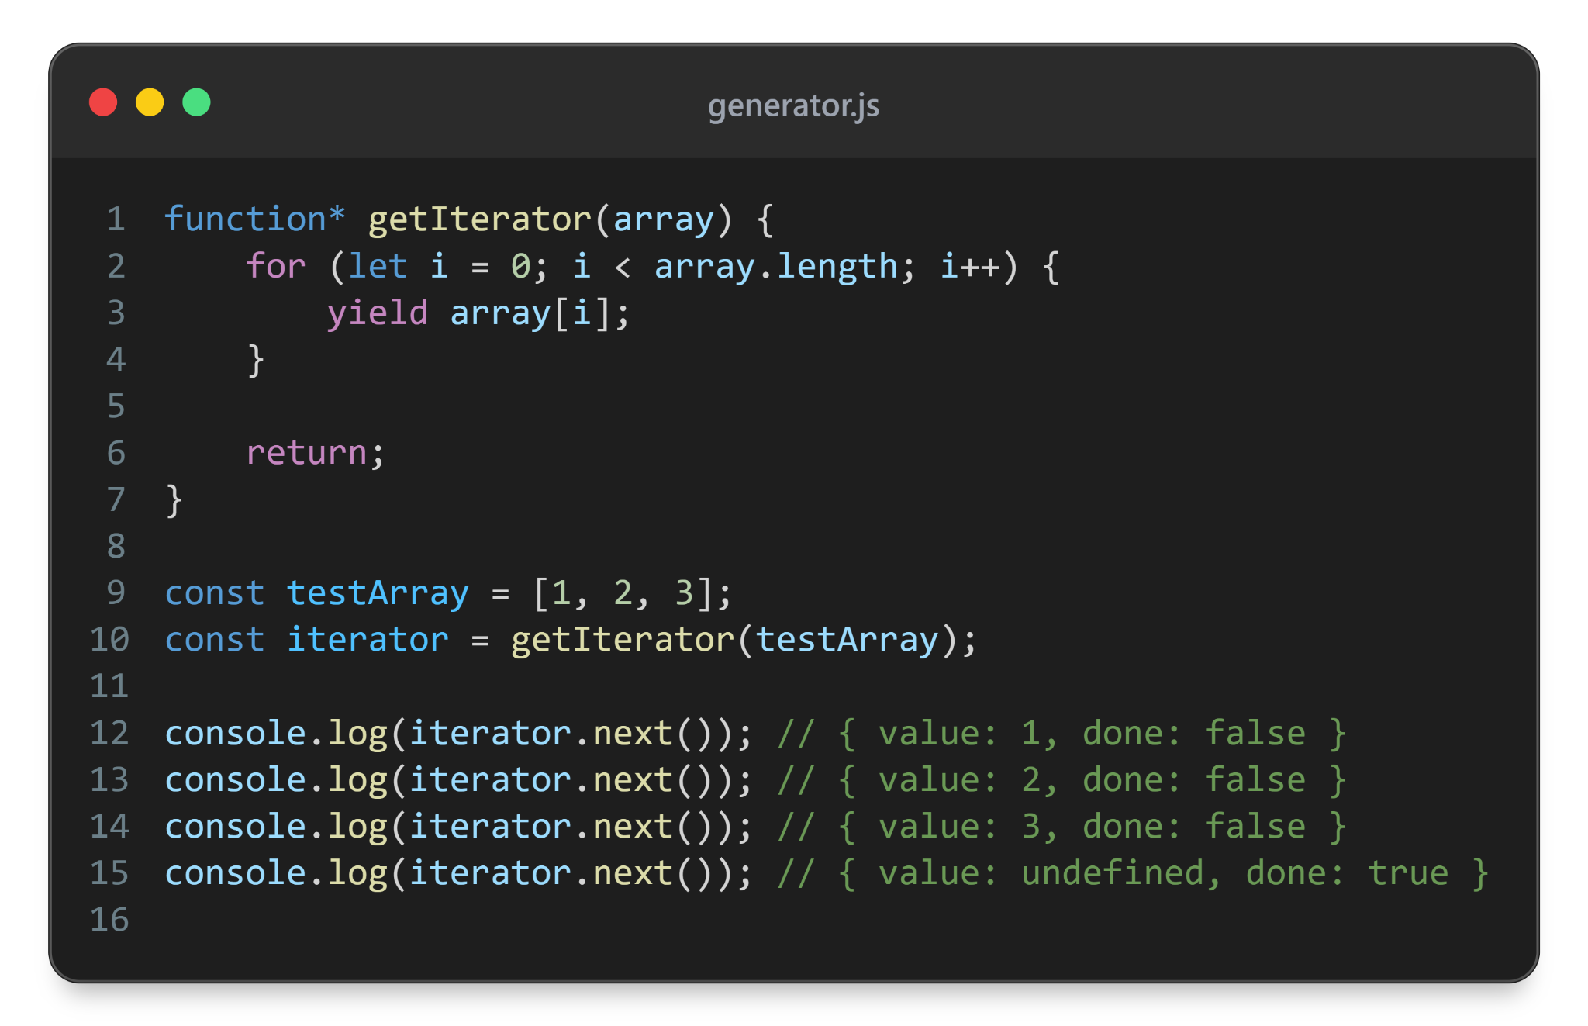

Slide 25

iterator = getIterator([testArray])
Global memory
*
iterator.next() —> getIterator()
getIterator
Local memory
yield array[0]
iterator
next
array
[1,2,3]
suspended
i
0
yield array[1]
suspended
yield array[2]
iterator.next()
iterator.next()
iterator.next()
done

Slide 26
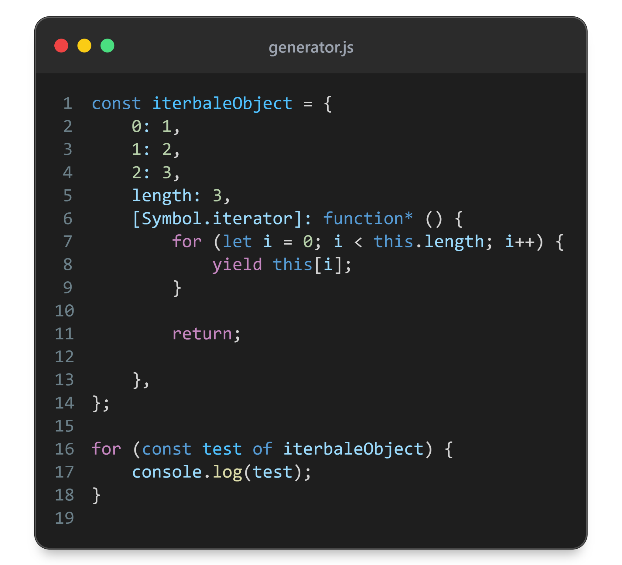

Slide 27
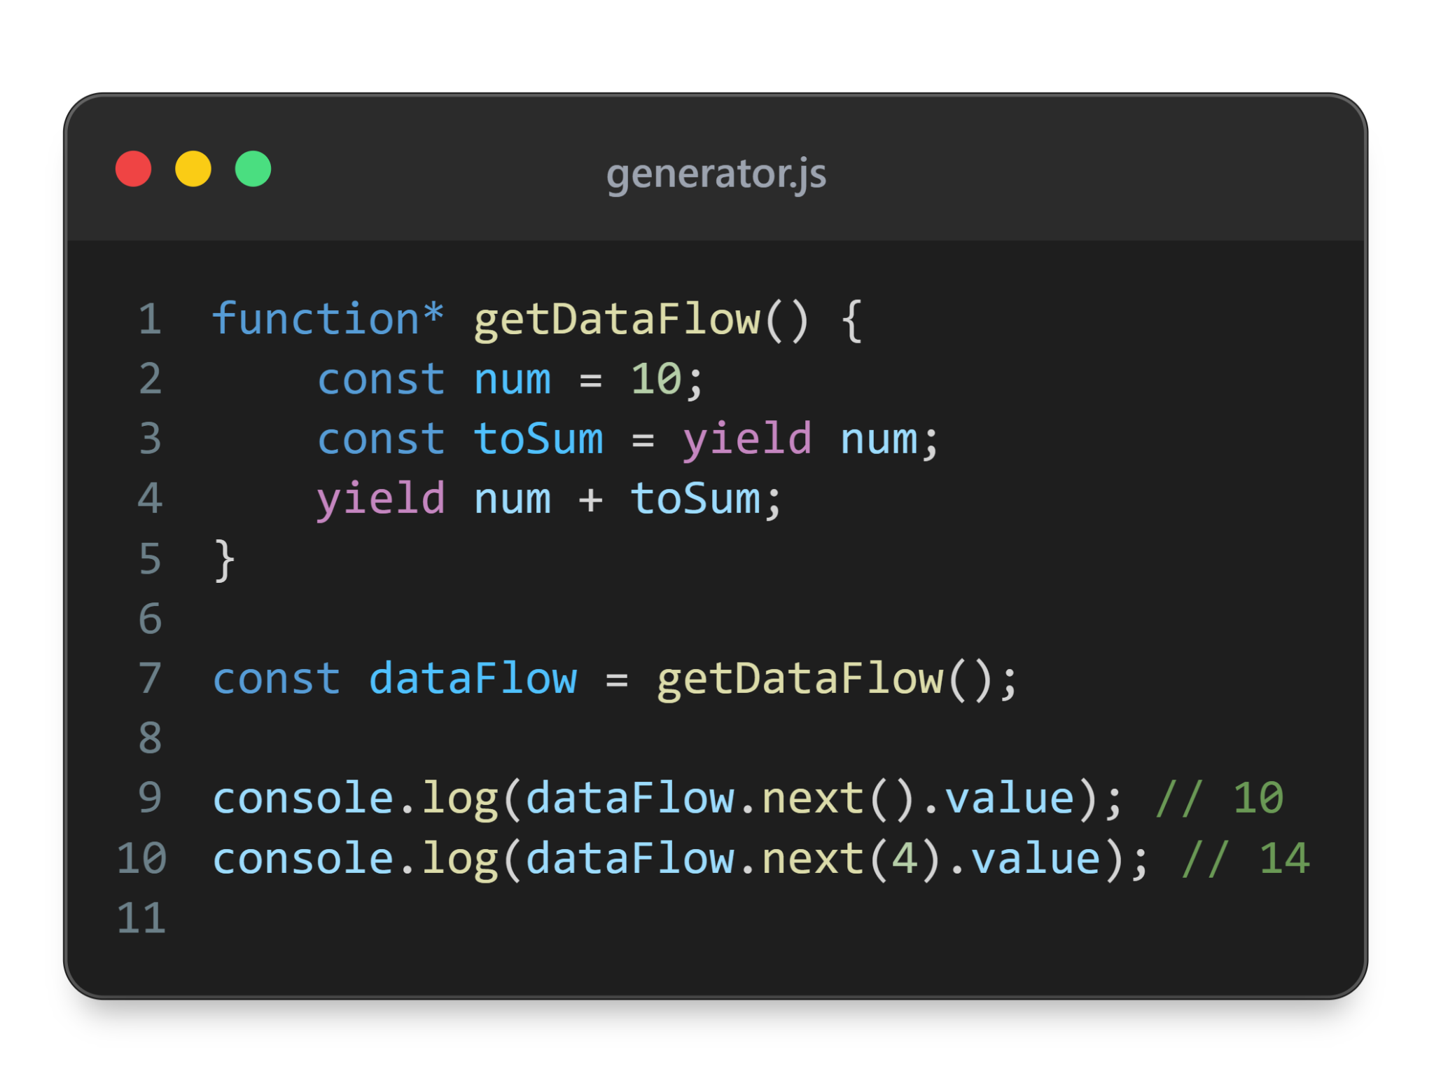

Slide 28
dataFlow = getDataFlow()
Global memory
*
dataFlow.next() —> getDataFlow()
getDataFlow
4
Local memory
toSum = yield num
dataFlow
next
num
10
suspended
toSumi
4
yield num + toSum
dataFlow.next(4)
done

Slide 29
Immutable Objects
Every field on an object has 3 internal property descriptors that determine actions that can be performed on the field

Slide 30
writable
boolean - determines if the value of a property can be changed

Slide 31
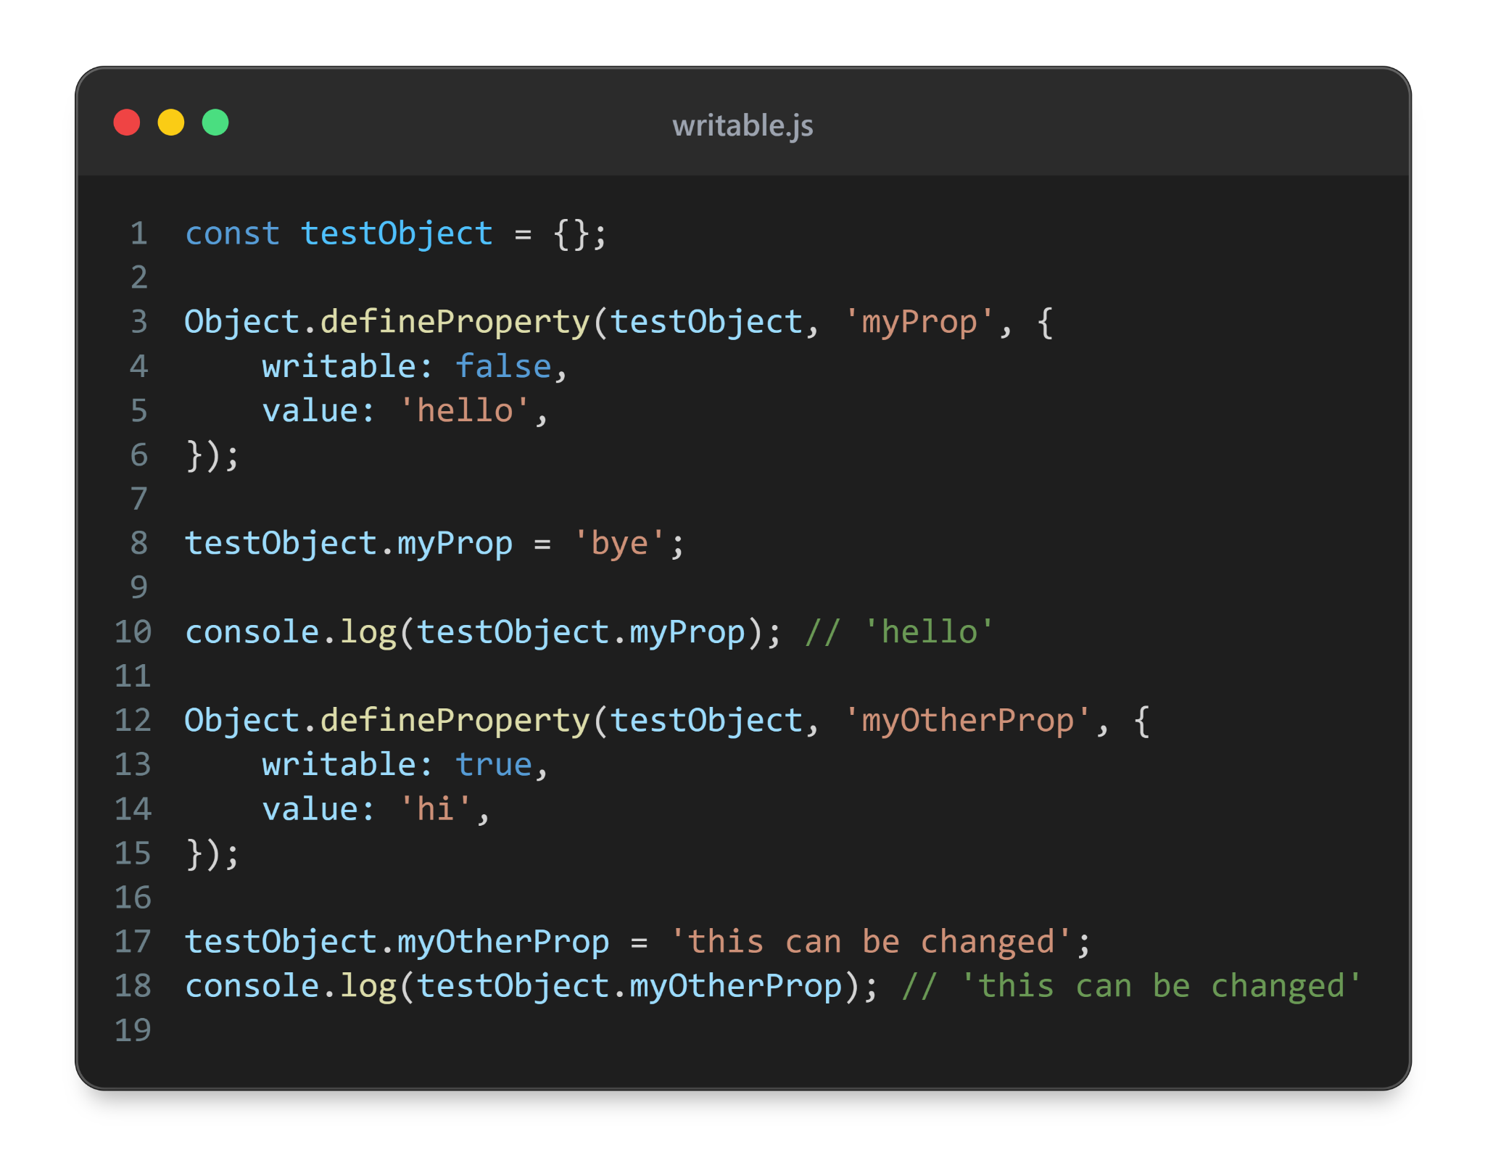

Slide 32
enumerable
boolean - determines if the property shows up in iteration

Slide 33
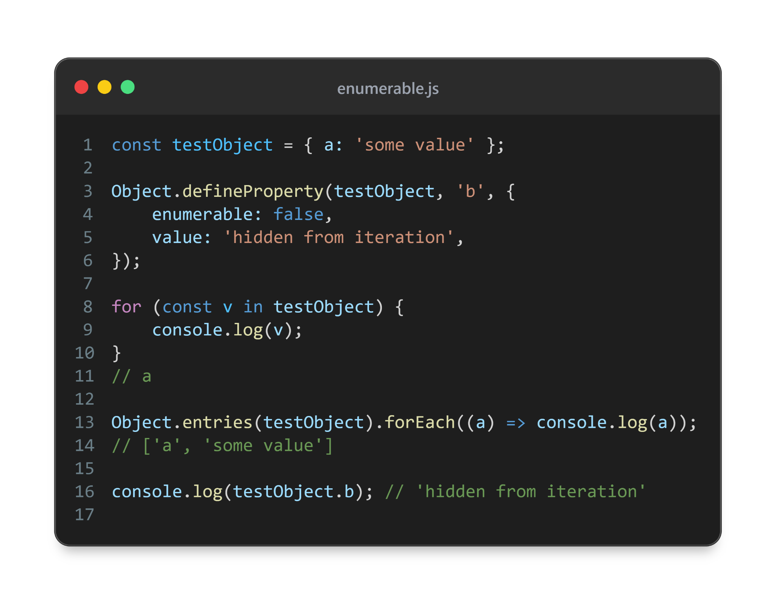

Slide 34
configurable
boolean - if false, property cannot be deleted, other descriptors can’t be changed expect for writable from true to false

Slide 35
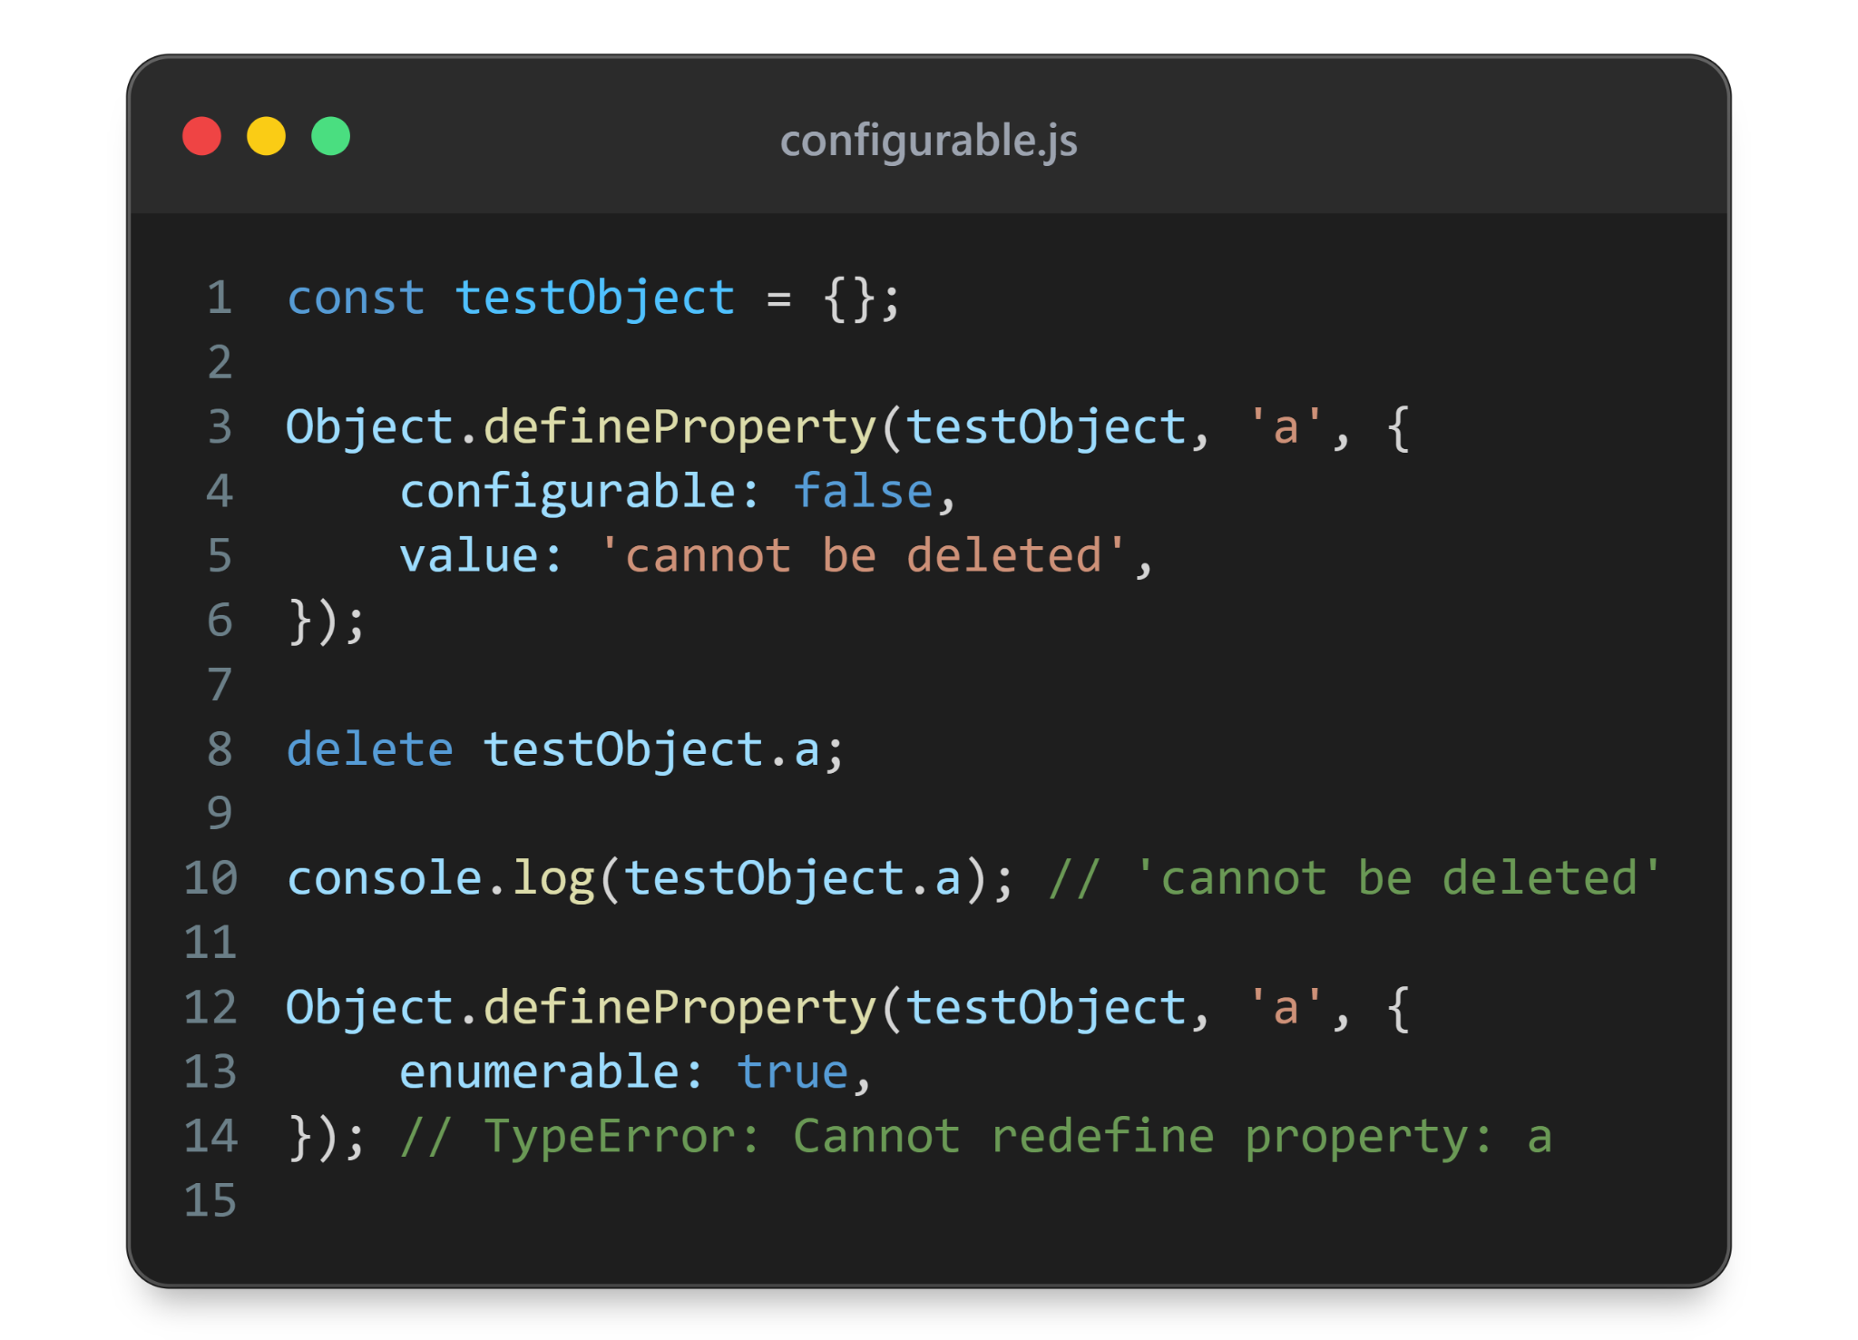

Slide 36
Object freeze
Object cannot be extended
All existing properties will have: writable: false, configurable: false
That means: no new properties, can’t change or delete existing ones
but if prop is an array or object, then it can still be changed (would require separate freeze)

Slide 37
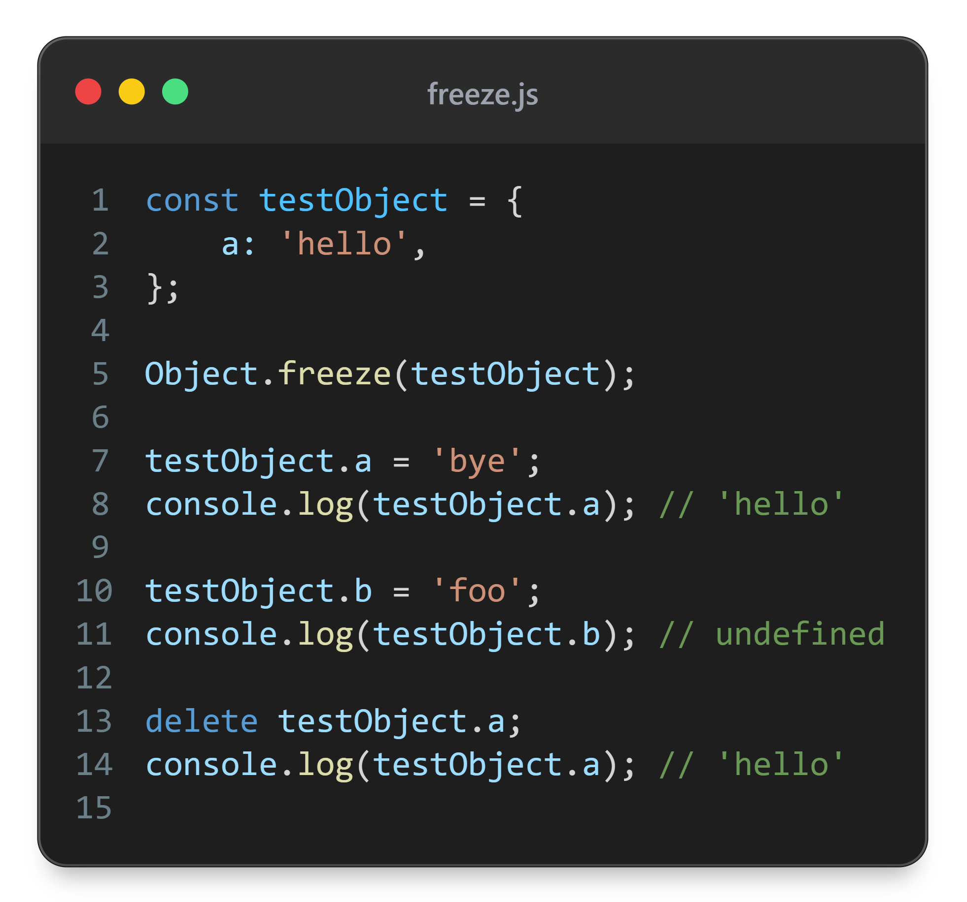

Slide 38
Object seal
Object cannot be extended
All existing properties will have: configurable: false
That means: no new properties, can’t delete existing ones, but still can change existing ones

Slide 39
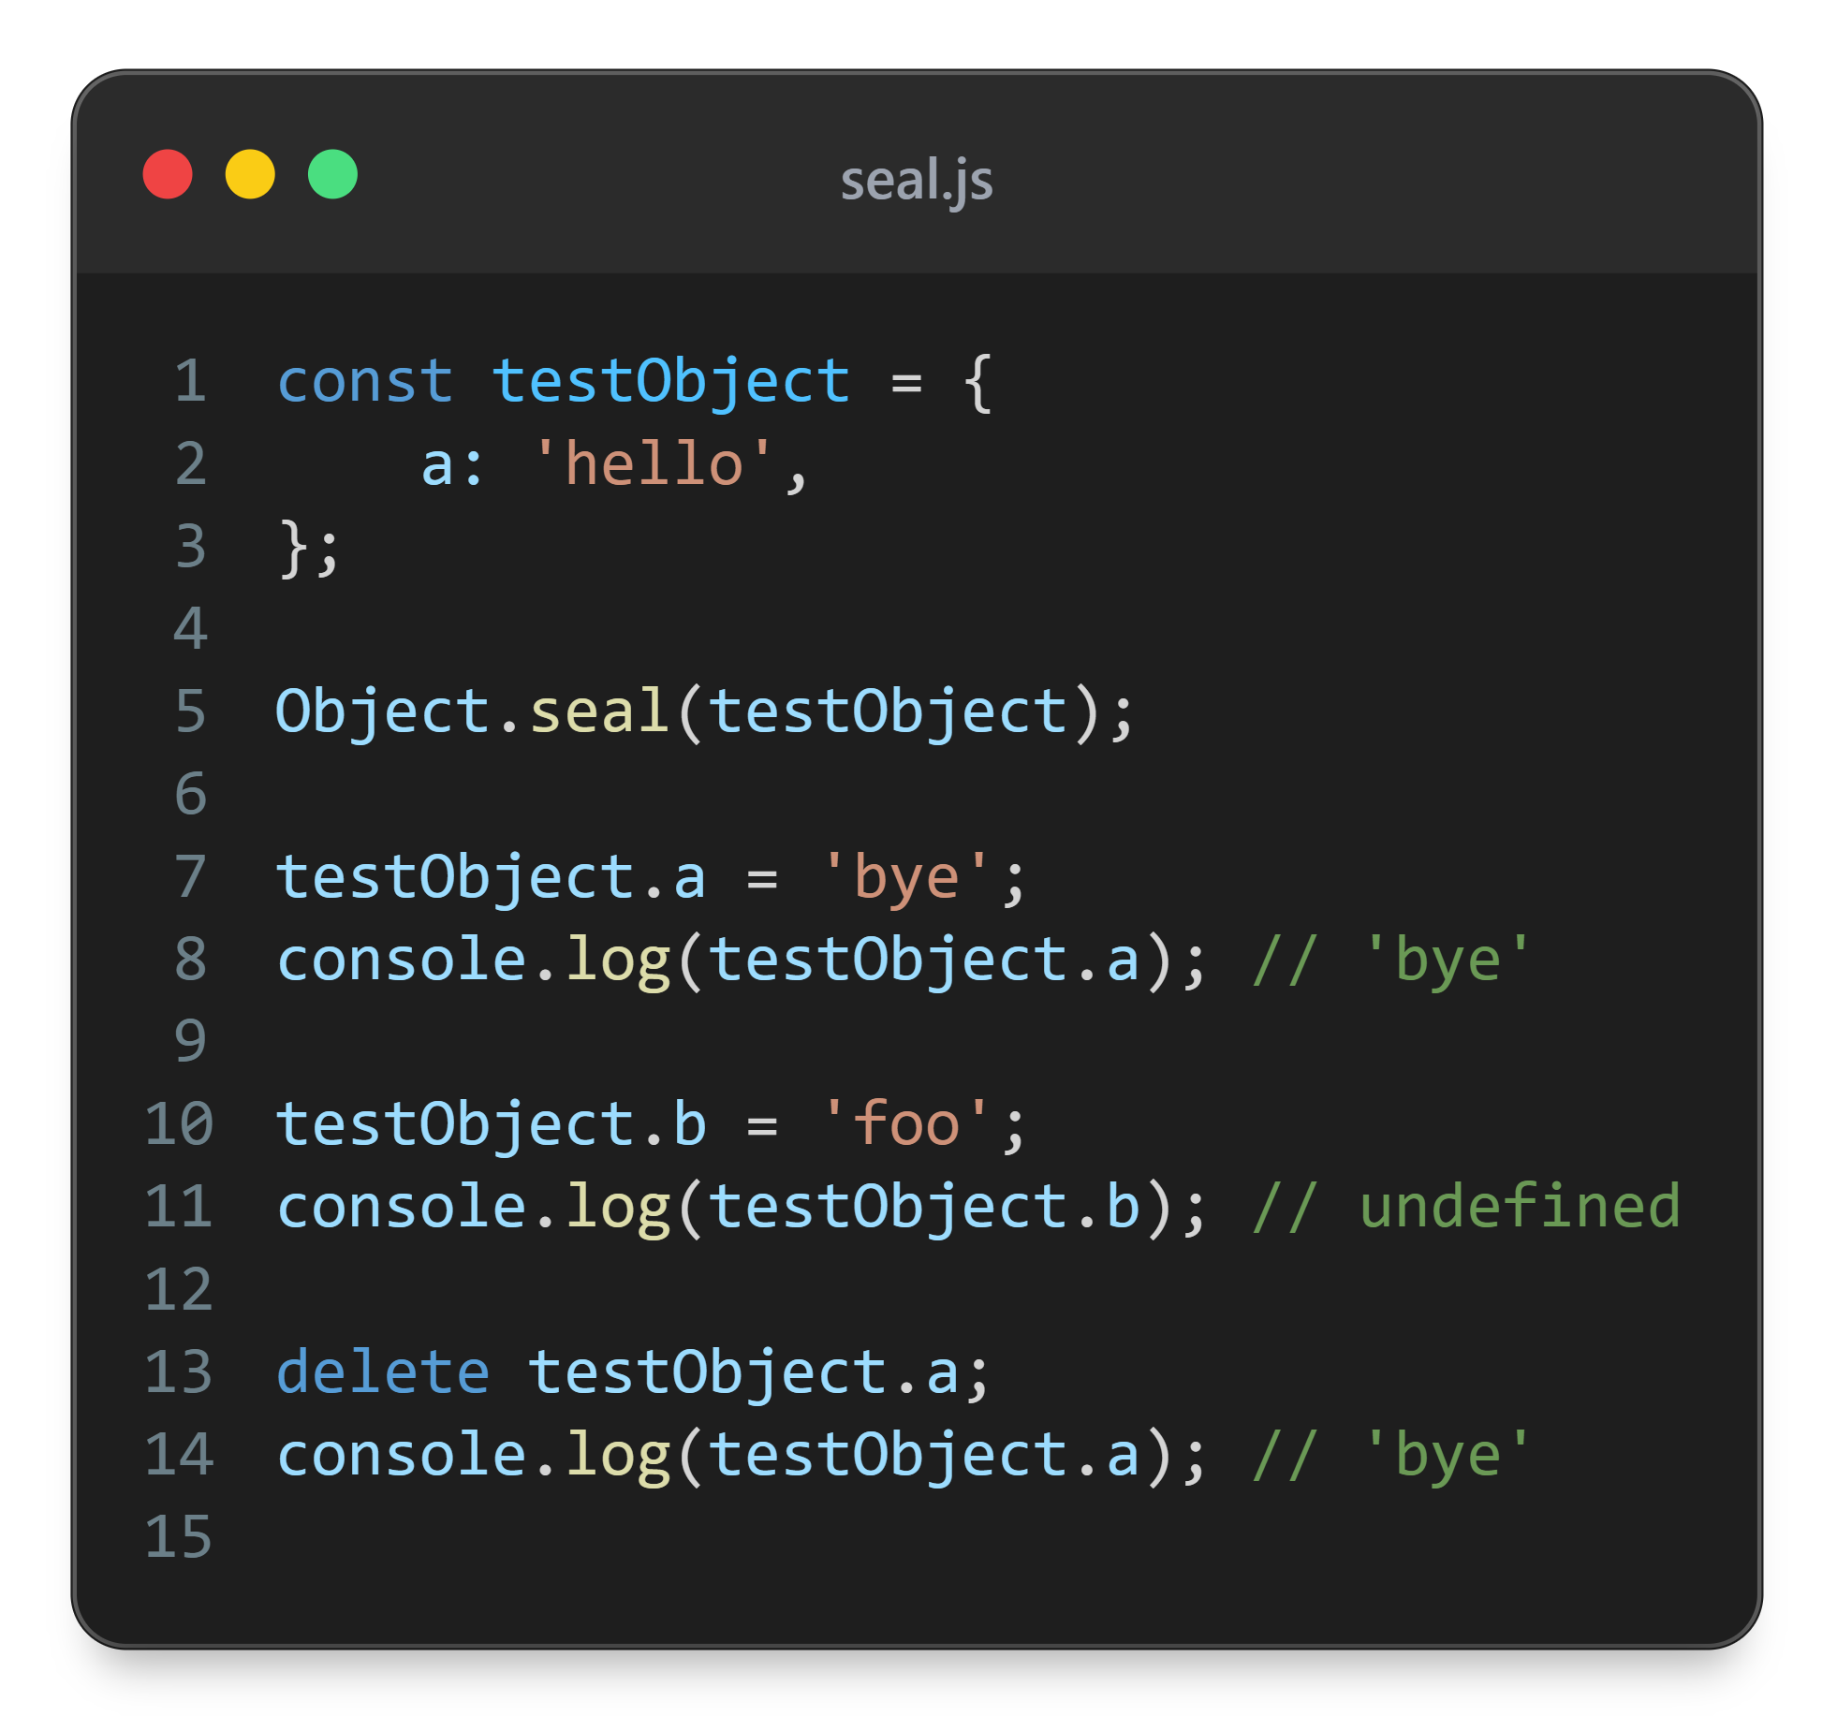

Slide 40


